Slide 1
Internet on the ocean
NASA Space Apps Challenge 2019

Slide 2
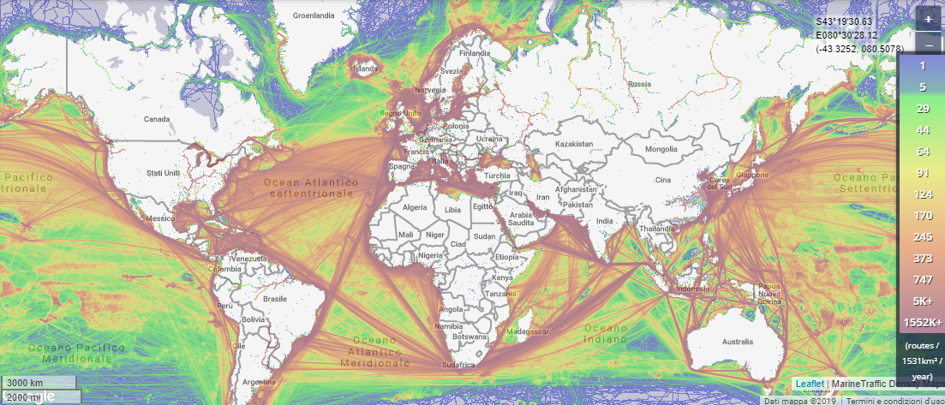
Our challenge

Slide 3
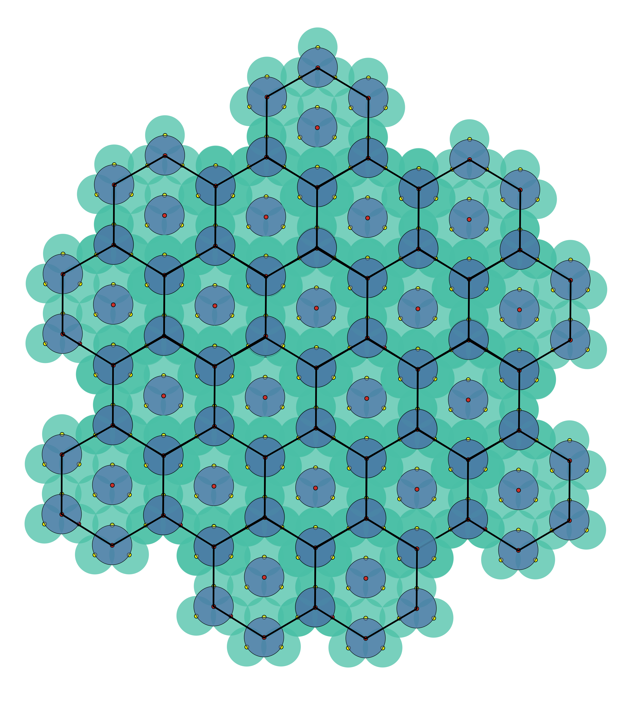
Oceanic Beehive
Advantages:
- Relatively cheap to realize
- Cheap subscription
- Easily scalable
- Auto sustainable alimantation
- Does not pollute
- High speed navigation
Disadvantages:
- Long developement time

Slide 4
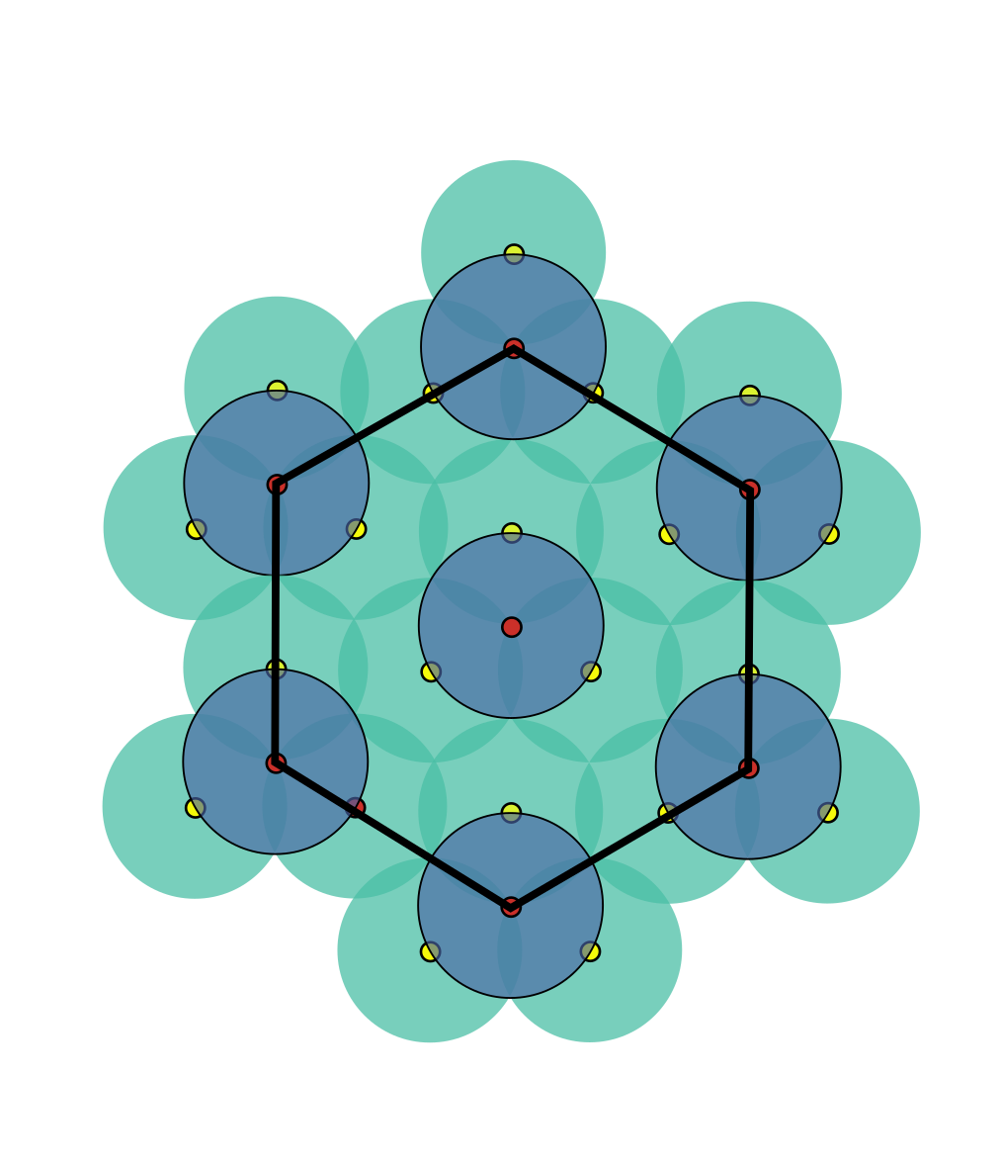
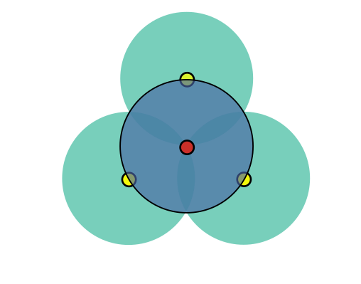

Slide 5


Base Station
Receives signal from satellite and repeats it to secondary station on a 50km radius area
Secondary Station
Provides internet on a 50km radius area

Slide 6
Structure of the STations
Structure:
- Mast
- Sectorial Radius
- Power Plant
- Surrounding structure
- Photovoltaic panels
- GPS
- Propellers

Slide 7
Constructions costs
One Station: €200.000
387 Base Stations: €77.000.000
1161 Secondary Stations: €232.000.000
1548 Total Structures: €309.000.000
Other costs: €11.000.000
Maintenance costs: 90€/month
Total: 320.000.000 €

Slide 8
Service costs
1€/day or 20€/month

Slide 9
Our team
- Abati Lorenzo
- Cabassi Daniele
- Contini Giacomo
- Montini Cristian
*detailed informations about the project on our paper

